Slide 1
Social Media Report
Notes:
Month at a glance
Web Stats – convert to 1 page
Social Results – convert to 1 page
Add page for TashRizzo: Omnichannel
Add Page for SUAS Linkedin Discussion

Slide 2


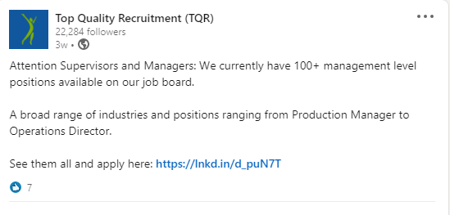

Top Posts for March 2021 LinkedIn
1,238
Impressions
37
Clicks
7
Reactions
3.8%
Engagement
1,194
Impressions
42
Clicks
6
Reactions
4.19%
Engagement
609
Impressions
13
Clicks
0
Comment
5.09%
Engagement

Slide 3




Top Posts for March 2021 Facebook
1.9K
People Reached
26
Clicks
50
Reaction
1.5K
People Reached
6
Clicks
40
Reaction
1.3K
People Reached
7
Clicks
26
Reaction

Slide 4

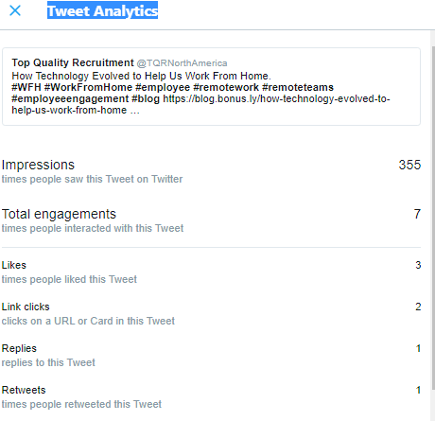


Top Posts for March 2021 Twitter

Slide 5
